Slide 1
Digital Communication 24EC2208
AY 2025-26
Delta Modulation and Demodulation

Slide 2
Delta Modulation
Delta modulation is a simplified version of DPCM:
* The prediction filter is first order
* The quantizer is two level ±Δ
High sampling rate
Analog signal is approximated by staircase function
Only a single binary digit is required for each sample
DM uses very simple hardware and is low cost for that reason.

Slide 3
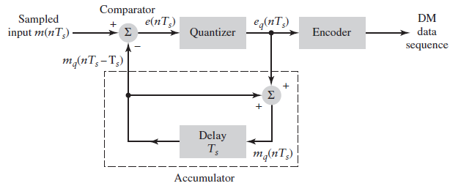




Delta Modulation
1 bit
±Δ
DM Transmitter

Slide 4
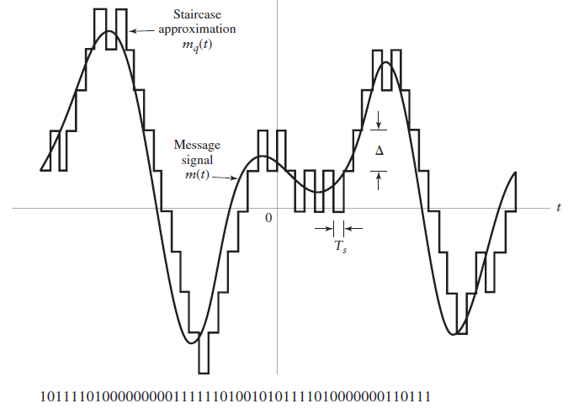

Slide 5
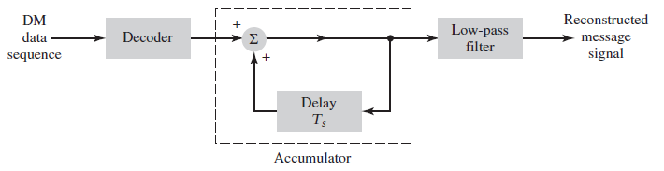
Receiver

Slide 6
Quantization errors in DM
Slope overload distortion
Granular noise

Slide 7
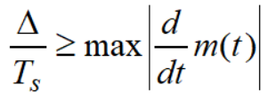
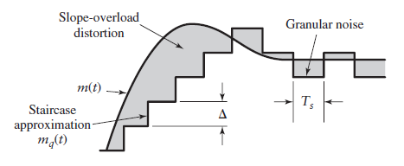
Slope overload distortion
Step size is too small
The condition for no over slope distortion is
Step size is too small

Slide 8
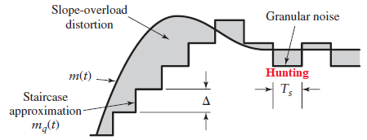
Granular noise
The step size is too large

Slide 9
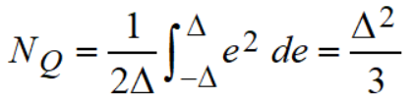
Quantization Noise in DM

Slide 10

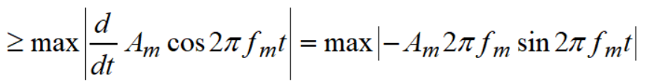

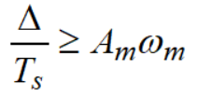
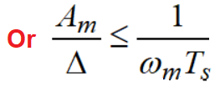
SQNR for DM
Consider an input signal
The condition for no slope overload distortion

Slide 11
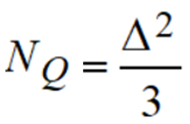
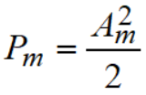
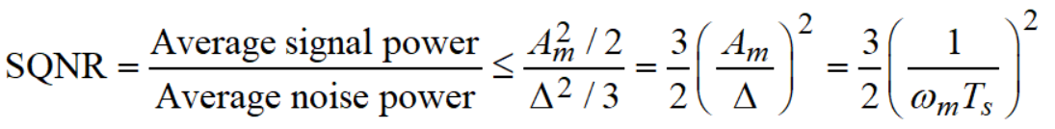
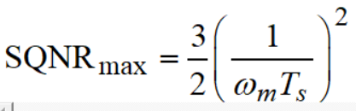

SQNR for DM…
The quantization noise power
The signal power
Then the Signal Quantization Noise Ratio
Does not depend on amplitude

Slide 12
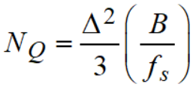
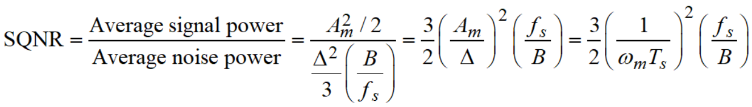
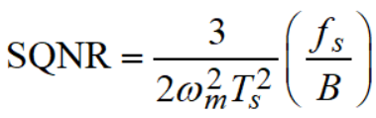

With the post reconstruction filter
Let the cut-off frequency of LPF at the receiver output be equal to message signal bandwidth ‘B’ Hz.
Then the noise power at the receiver output
Then the Signal Quantization Noise Ratio

Slide 13
End

